Slide 1

Battle of the neighborhoods
NYC Beach Neighborhoods

Slide 2

introduction
Recently, there has been a massive influx of young people moving to and working in NYC, NY. We represent a large real estate firm for young professionals. A new client would like to move to a neighborhood in NYC that has access to beaches and yoga studios, as well as restaurants. Price range is not a limitation. The purpose of this project is to help this young professional determine which neighborhoods they should live in that has access to beaches and yogo studios and restaurants.

Slide 3

problem
The major purpose of this project is to provide a list of potential neighborhoods in NYC, NY for our client that matches her needs. We will use this data to suggest a neighborhood for her to move into and buy real estate.

Slide 4



DATA For this project, we need:
New York City data
Boroughs, Neighborhoods along with their latitude and longitudes
Geospace data
FourSquare API as its prime data gathering source as it has a database of millions of places, especially their places API which provides the ability to perform location search, location sharing and details about a business.
Foursquare API endpoint, parameters, credentials, categories
Venue information and location

Slide 5
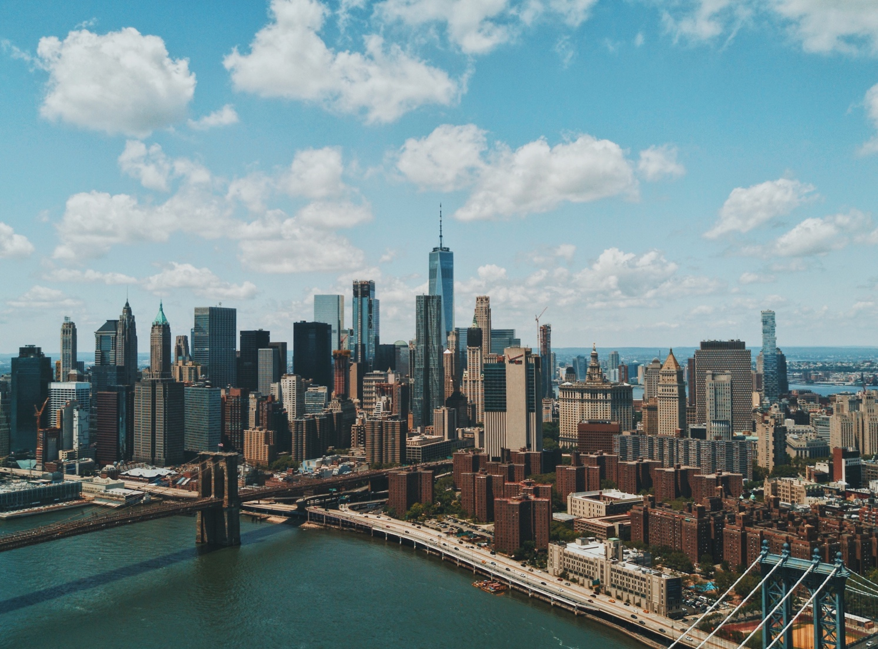
location
New York City is a bustling metropolis that spans 5 boroughs in the State of New York. While it is known for it's nonstop nightlife, it also has many recreational studios, beaches, parks, and markets.

Slide 6
METHODS
Collect json files from NYC data set
Transfer json into Pandas datafram
Clean and process data
Search FourSquare API endpoint for venues in NYC
Select relevant data – venue, venue type, location
Visualize number of venues per neighborhood
Categorize venues and display common venue types per neighborhood
K-means clustering and mapping

Slide 7
RESULTS

Slide 8
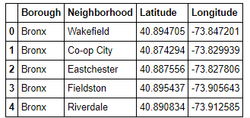
Adding latitude and longitude data to borough and neighborhood datafram

Slide 9
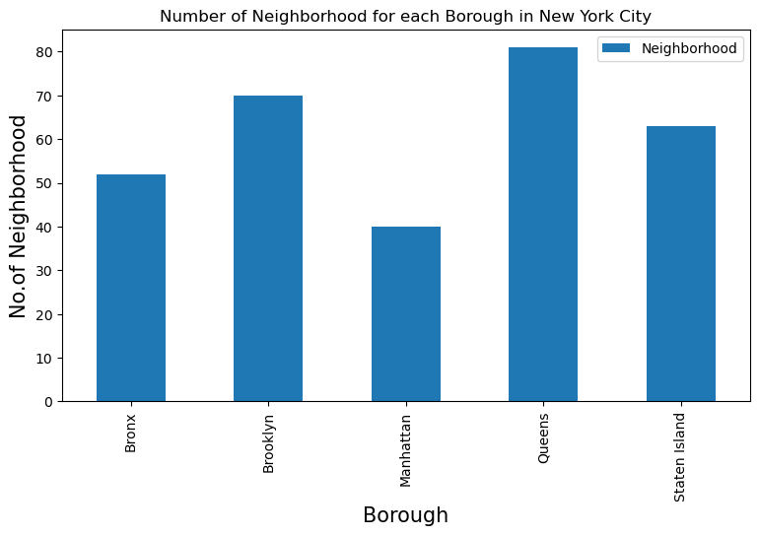
NUMBER of neighborhoods per borough

Slide 10
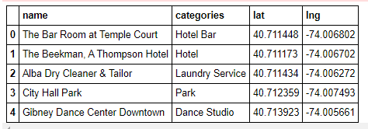
SCRAPING venue names, categories, and locations

Slide 11
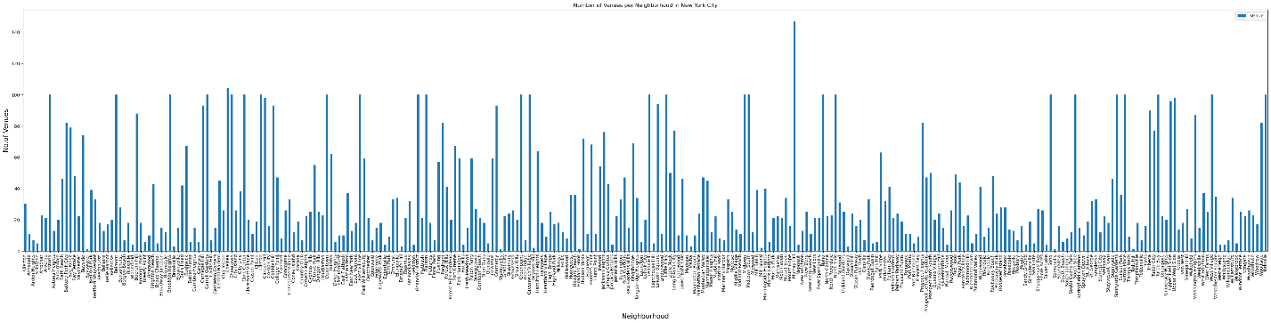
Number of venues per neighborhood

Slide 12
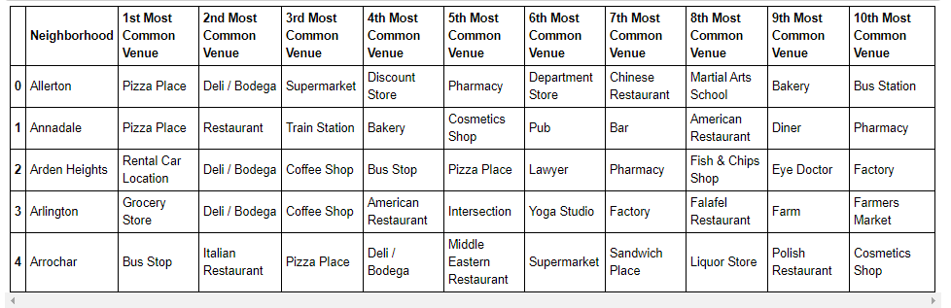
Top ten most common venues per neighborhood

Slide 13
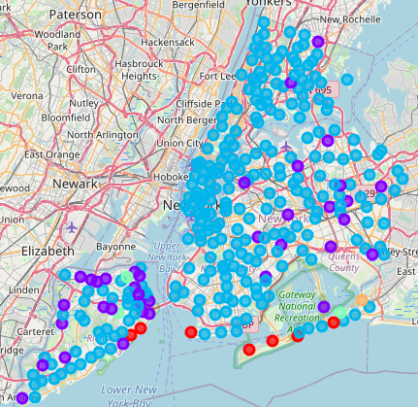
K-mean clustering of venues per neighborhood

Slide 14
Discussion
From the results, we recommend to our client to select one of the following neighborhoods to invest in real estate. These neighborhoods, all in Cluster #1, had a high concentration of beaches and yoga studios. This includes the neighborhoods of:
Sea Gate
Breezy Point
Neponsit
South Point
Midland Beach
Roxbury
Although Hammel has beach access, it is not a suitable neighborhood for our client as it has no yoga studios and a lesser number of restaurants.

Slide 15
Conclusion
From the results, we recommend to our client to buy real estate Sea Gate, Breezy Point, Neponsit, South Point, Midland Beach, Roxbury neighborhoods. Some additional analysis should be made to understand if properties are available in these neighborhoods.

